Slide 1
Full Calendar

Slide 2
Activity table

Slide 3
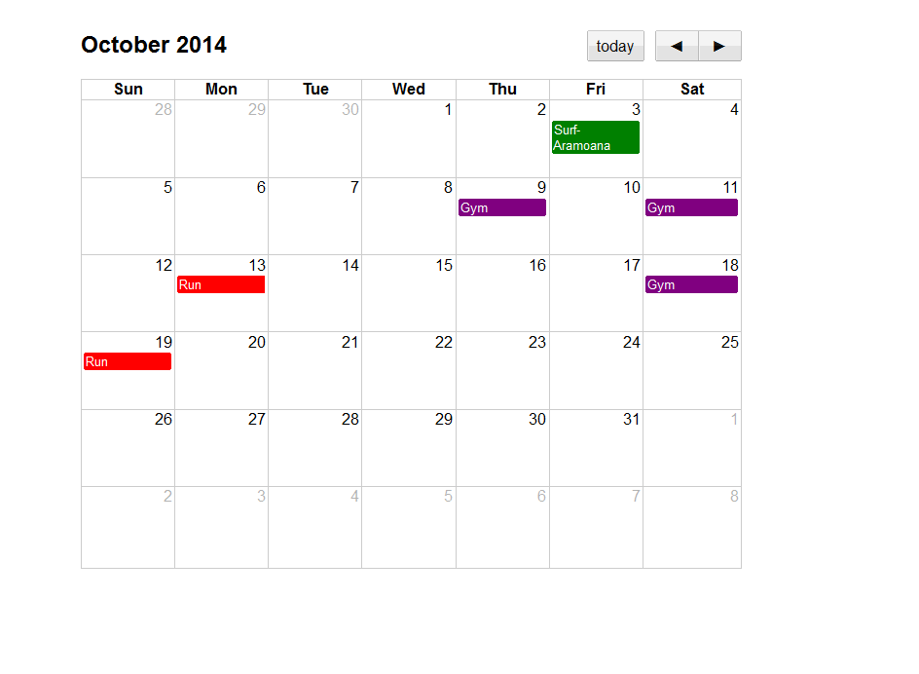

Slide 4
JSON
JavaScript Object Notation
Notes:
Our final, and looking toward the future, most important, data file format.
JSON is like XML – a text schema for representing hierarchical data
JSON is newer, and rapidly gaining popularity, primarily because it requires fewer characters.
Where XML uses verbose tags, JSON uses {} and [] and other tokens from programming language syntax. It also allows easy indexing into and iteration over collections of elements (while XML does not).
Although called JavaScript Object Notation, JSON doesn’t really have anything to do with JavaScript per se (although it is frequently used as a data representation format in JavaScript code).
It simply uses the same syntactic notation for defining objects (nodes) and arrays (collections of sibling nodes).

Slide 5
JSON – Formal Definitions
Two structures:
Objects: A collection of key-value pairs
Arrays: An ordered list of values
Notes:
We’ll see exactly what a value is in a moment
Let’s look at the formal definition of the JSON syntax rules. These diagrams are worth getting used to. They are often provided to define language rules.

Slide 6
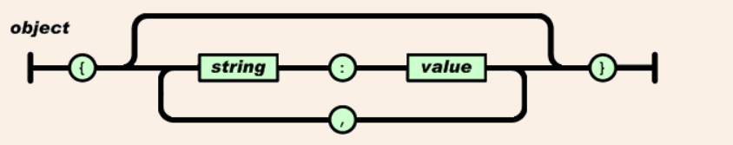
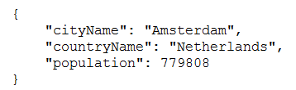
JSON – Formal Definitions
Notes:
Just follow the paths
An object starts with a { and ends with a }
In between there are zero or more elements, separated by commas.
Each element is a string, followed by a :, followed by a value (we’ll see exactly what a value is in a moment)
Here is a simple JSON object. Three key-value pairs; each value a simple scalar string.
If you’ve ever made objects in JavaScript, you will recognise the syntax.
The indentation – and in fact, the line feeds – are irrelevant. That’s just for people. JSON parsers ignore that stuff.
We will see in a moment that the value can actually be quite complicated, allowing for nested structures, multiple structures, etc.

Slide 7
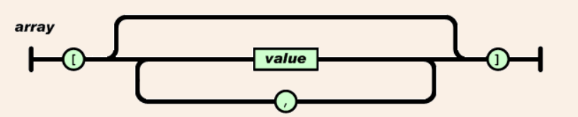

JSON – Formal Definitions
Notes:
An array starts with [ and ends with ]
In between is a comma-separated list of values
Here is a simple example, where the values are just strings.
As mentioned before, value can be lots of things.
Let’s look at the diagram for value...

Slide 8
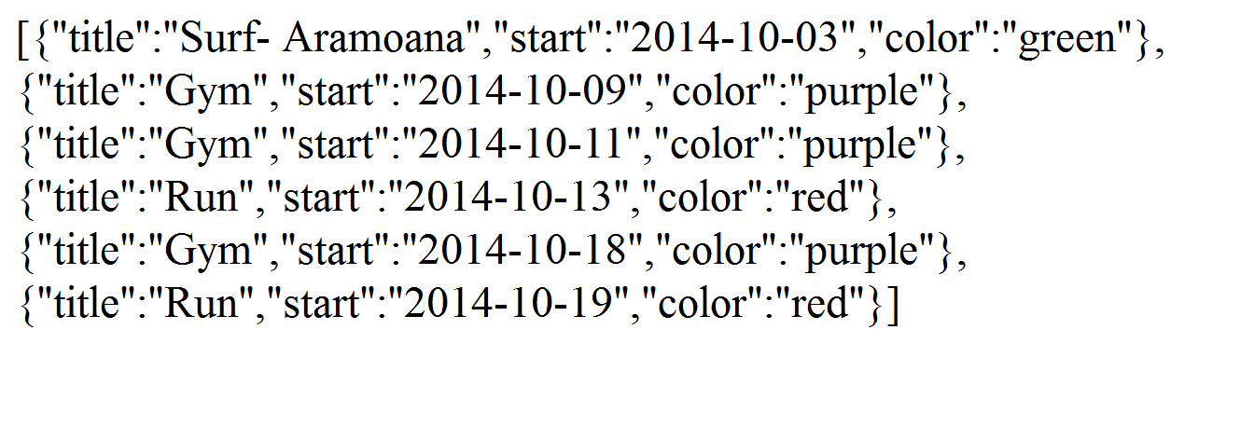
Full calendar needs an array of JSON objects

Slide 9
php
//mine is dummy data you will need to select for a particular userId
$selectString = "SELECT * FROM tblWorkout";
$result = $pdo->query($selectString);
$events = array();$color = "green";
foreach($result as $row )
{ $eventArray['title'] = $row['title'];
$eventArray['start'] = $row['date'];
//code a switch on $row['title']
$eventArray['color'] = $color;
$events[] = $eventArray;
}
echo json_encode($events);

